Slide 1
Survival analysis
Rebekka Füllemann, Janne Berger
NCIT:C3355 Respiratory System Neoplasm

Slide 2
Respiratory system neoplasm
- A benign or malignant, primary or metastatic neoplasm involving the respiratory system (Tracheal, Lung, Bronchial) [1]
- Lung cancer is the number one cause of cancer deaths among men and women worldwide [2]
- Our final dataset contains information about various lung carcinomas
- Carcinoma is cancer that forms in epithelial tissue

Slide 3
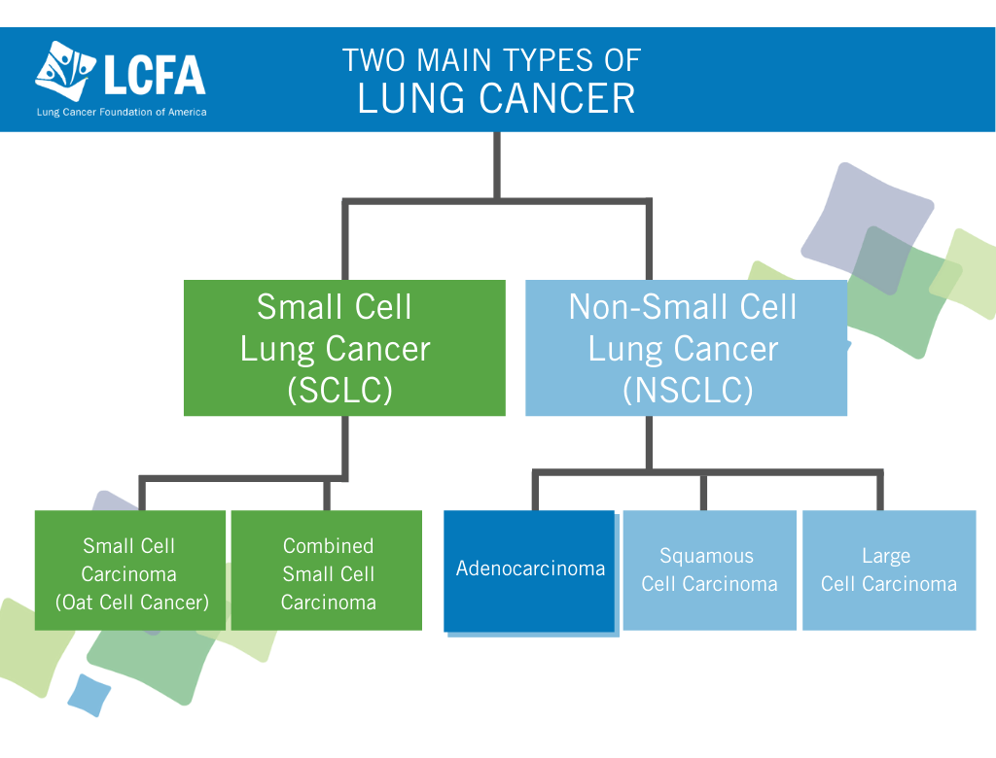
[i]

Slide 4
Overview diagnoses
- C3493 Squamous cell lung Carcinoma
- C3512 Lung Adenocarcinoma
- C4038 Lung Carcinoid Tumor
- C4450 Lung large cell Carcinoma
- C4917 Lung small cell Carcinoma
- C5672 Lung large cell neuroendocrine Carcinoma
- C9133 Lung adenosquamous Carcinoma

Slide 5
DAtasets
- “lung.csv”: contains all information about patiens
- “ERBB2.tsv”: contains information about patients with copy number gain in that gene
- “MYC.tsv”: contains information about patients with copy number gain in that gene
- “TP53.tsv”: contains information about patients with copy number deletion in that gene
- “CDKN2A.tsv”: contains information about patients with copy number deletion in that gene
- Merge of “lung.csv” with “genes.tsv” leads to final dataset for analysis

Slide 6
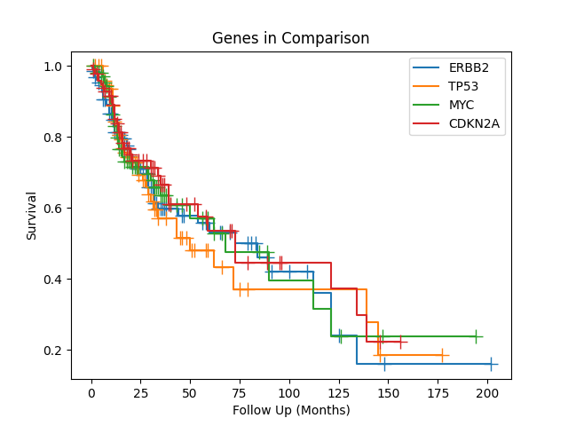
Analysis

Slide 7
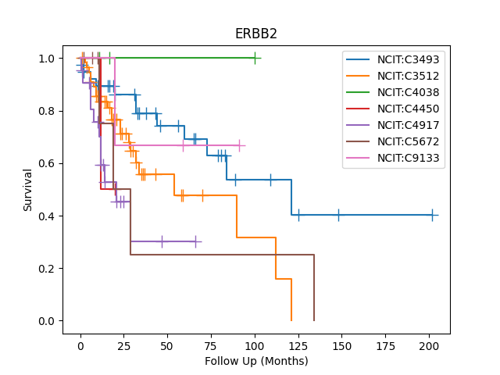
Squamous cell lung Carcinoma
Lung Adenocarcinoma
Lung Carcinoid Tumor
Lung large cell Carcinoma
Lung small cell Carcinoma
Lung large cell neuroendocrine carcinoma
Lung adenosquamous carcinoma

Slide 8
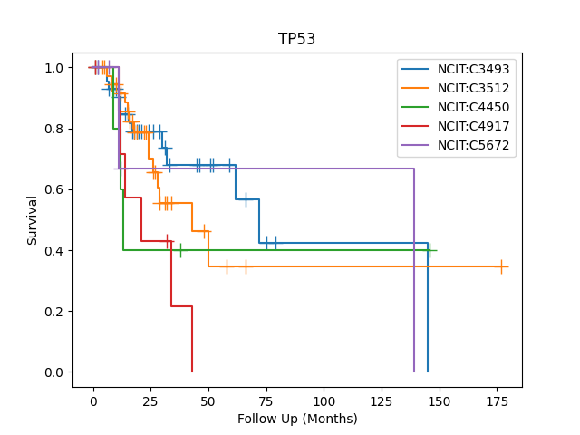
Squamous cell lung Carcinoma
Lung Adenocarcinoma
Lung large cell Carcinoma
Lung small cell Carcinoma
Lung large cell neuroendocrine carcinoma

Slide 9
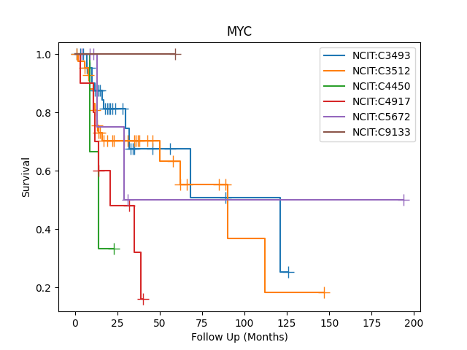
Squamous cell lung Carcinoma
Lung Adenocarcinoma
Lung large cell Carcinoma
Lung small cell Carcinoma
Lung large cell neuroendocrine carcinoma
Lung adenosquamous carcinoma

Slide 10
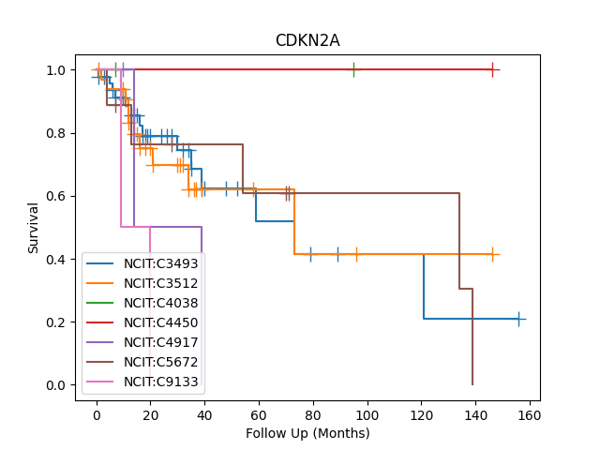
Squamous cell lung Carcinoma
Lung Adenocarcinoma
Lung Carcinoid Tumor
Lung large cell Carcinoma
Lung small cell Carcinoma
Lung large cell neuroendocrine carcinoma
Lung adenosquamous carcinoma

Slide 11
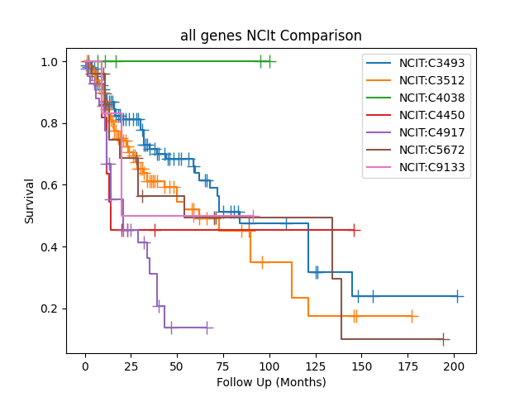
Squamous cell lung Carcinoma
Lung Adenocarcinoma
Lung Carcinoid Tumor
Lung large cell Carcinoma
Lung small cell Carcinoma
Lung large cell neuroendocrine carcinoma
Lung adenosquamous carcinoma

Slide 12
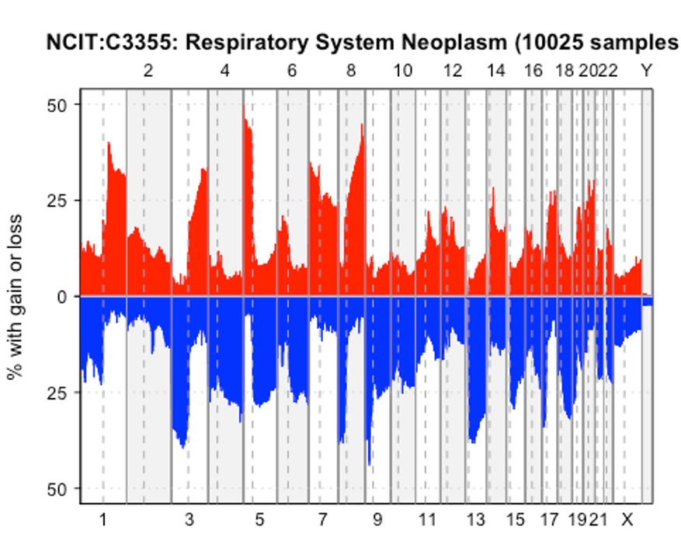

Slide 13
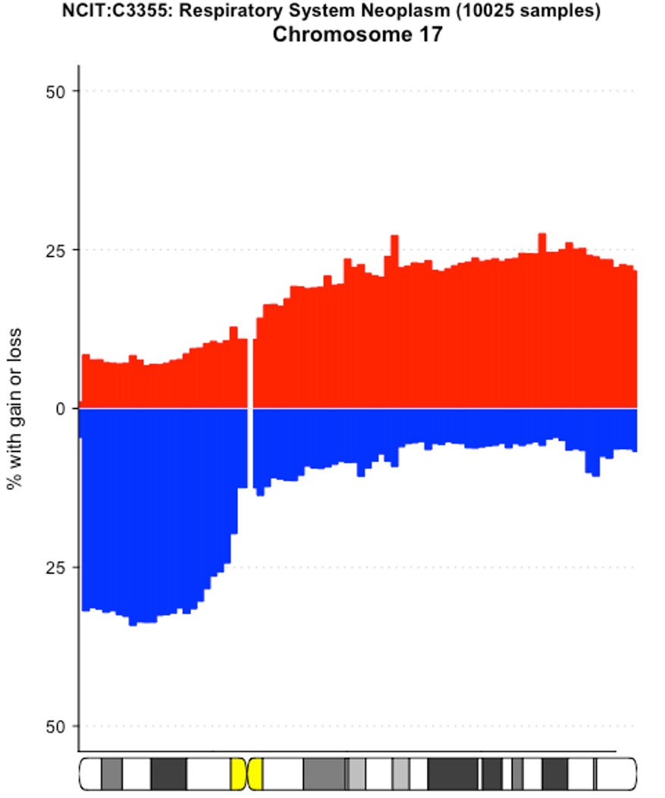
ERBB2
TP53

Slide 14
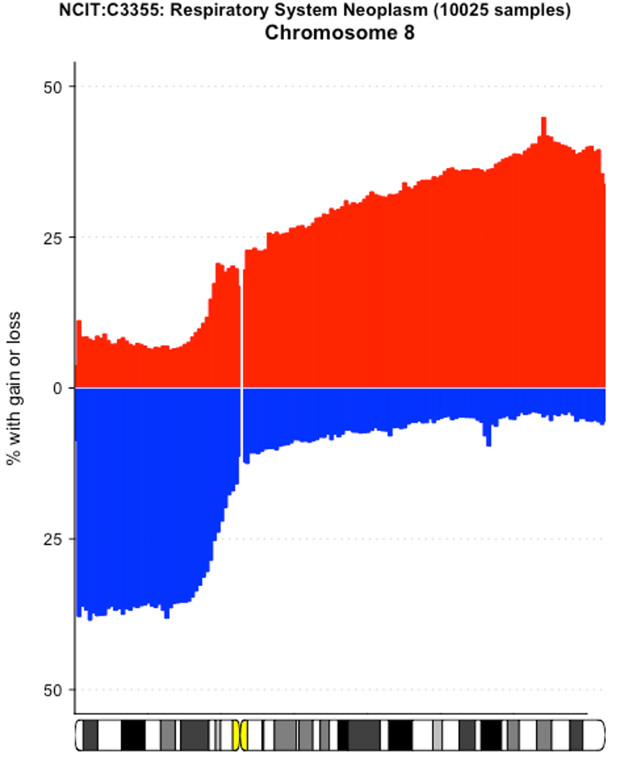
MYC

Slide 15
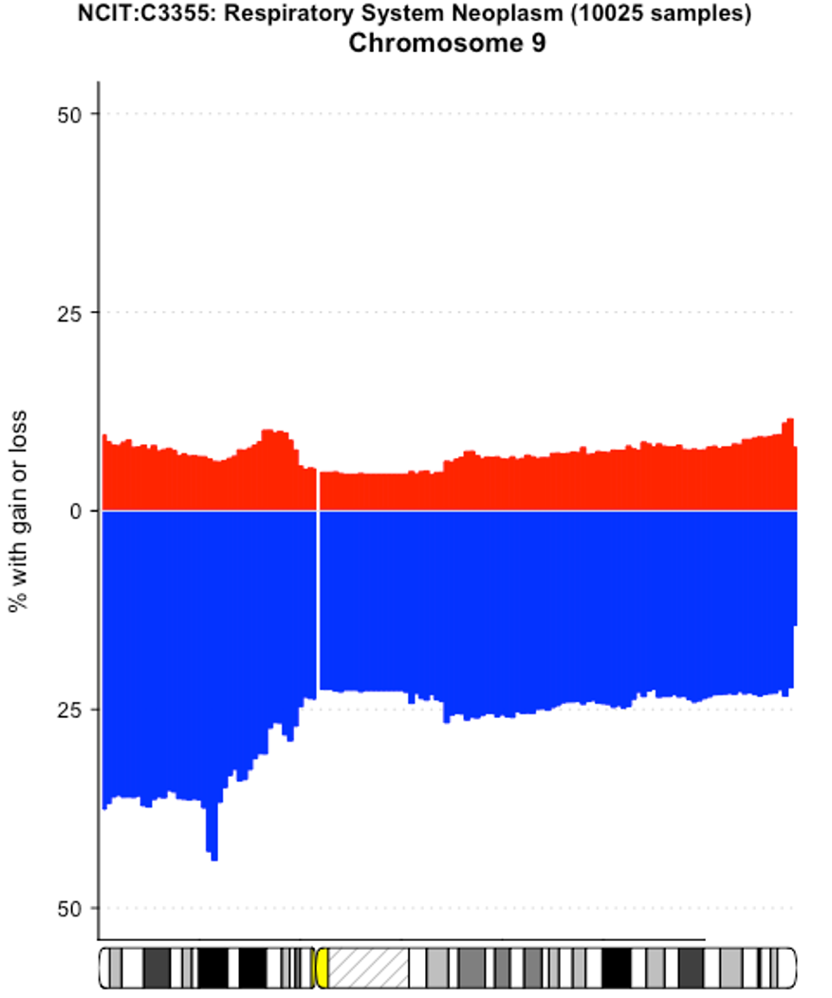
CDKN2A

Slide 16
sources
- [1] https://ncithesaurus.nci.nih.gov/ncitbrowser/pages/concept_details.jsf?dictionary=NCI_Thesaurus&version=22.04d&code=C3355&ns=ncit&type=all&key=null&b=1&n=0&vse=null
- [2] https://wvcancercenter.com/specific-cancers/respiratory-cancer-facts/

Slide 17
pictures
- [i] https://lcfamerica.org/wp-content/uploads/2020/10/type-of-cancer-adenocarcinoma-1024x780-1.png

